Slide 1
UI Development
By : Harshiv Patel
05/01/2022
Notes:
- Why generic sessions ? - Why have I written Ui dev.
-

Slide 2

Notes:
We are going to know What are the technologies involved in to UI Development.
Why these technologies are important.
How the web works.
And Many more.
User – browser – url – dnsserver – server – website ip : 142.250.199.174

Slide 3
01 Technologies
02 Roles & Responsibilities of UI Dev
03 Mockups
04 Convert mockup to HTML

Slide 4

01
Technologies

Slide 5
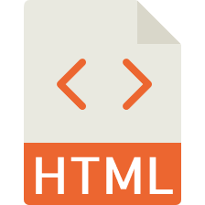
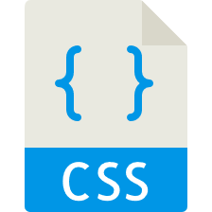




Technologies
HTML
CSS
JavaScript
Bootstrap
Sass/SCSS
jQuery
Notes:
- Difference between library and framework

Slide 6

02
Roles & Responsibilities of UI Dev

Slide 7

Roles & Responsibilities of UI Dev
A UI developer uses a combination of HTML, CSS, and JavaScript to build the client-side or user-facing portion of a website—which includes everything from front-end features like drop-down menus and shiny call-to-action buttons, to the overall manner in which photos, articles, videos, and other content are displayed in your web browser.

Slide 8
Roles & Responsibilities of UI Dev
Develop new user-facing features
Build reusable code and libraries for future use
Ensure the technical feasibility of UI/UX designs
Optimize application for maximum speed and scalability
Collaborate with other team members and stakeholders
Proficient understanding of web markup, including HTML5 and CSS3
Basic understanding of CSS pre-processing platforms, such as LESS and SASS
Strong knowledge of web standards
Proficient understanding of cross-browser compatibility issues and ways to work around them
Familiarity with differences in other HTML5 based views, such as ones in email clients
Fair understanding of JavaScript programming and DOM manipulation
Solid understanding of the relationship between HTML and search engine optimization (SEO)
Good understanding of SEO principles and ensuring that the application will adhere to them
Proficient understanding of code versioning tools, such as {{Git / Mercurial / SVN}}
Notes:
- Web Standards is defined as a formal set of standards and technical specifications used to define aspects of the world wide web. These are best-practice standards used by organizations to build web sites and web applications.

Slide 9
03
Mock-up

Slide 10
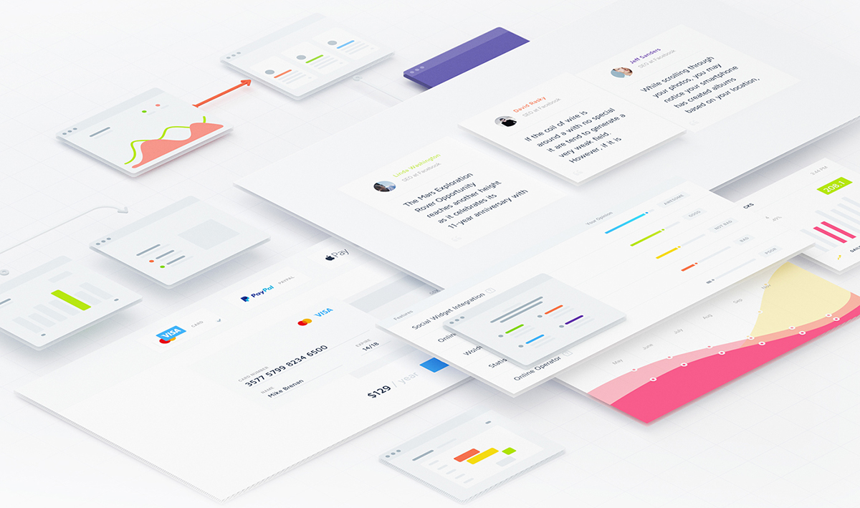
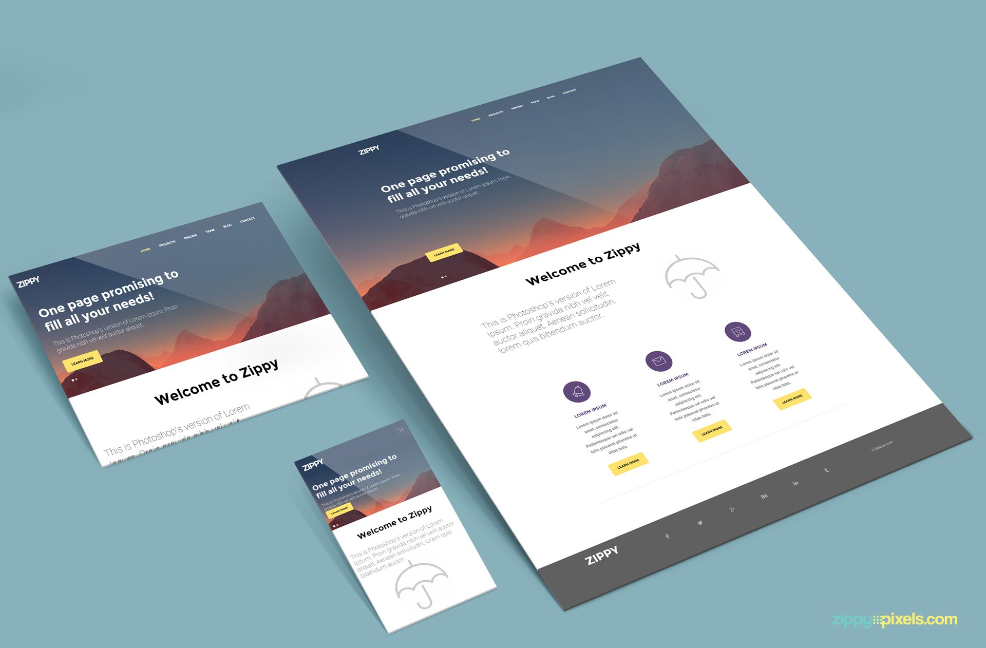
Mock-up
A mockup is a realistic representation of what the product will look like, in this case a website. The final result can look exactly like the mockup, or be a variation of it after version revisions. While some people prefer to draw the mockups using graphic software, others do it straight in HTML/CSS.
Typically mid to high fidelity, mockups reflect the design choices for color schemes, layouts, typography, iconography, the visuals of navigation, and the overall atmosphere of the product.
Notes:
The application protocol that makes the web work is HTTP. HTTP is the protocol that web browsers and web servers use to communicate with each other over the Internet.
Explain the example of any login page.
This is the very basic architecture of how the web works.

Slide 11
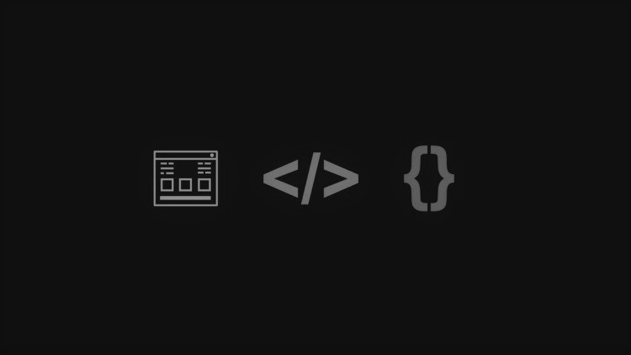
04
Convert Mock-up to HTML

Slide 12
Convert Mock-up to HTML
Few things to remember & keep in mind before start HTML by referring to any mock-up:
Scan and analyse the mock-up
Create basic HTML ‘Containers’
Add Minimal Content
Add External CSS, Elements and Classes
Add custom CSS (as needed)

Slide 13
UI Development
Notes:
Every web page on the internet uses HTML, CSS and JavaScript
Think of them as the foundational coding languages of the internet.
As we have so many language to interact with humans like Gujarati, Hindi and English, web pages also have languages.
In the case of websites their languages are HTML, CSS and JavaScript.
You may have heard about them, but do you really know why & how they work?

Slide 14
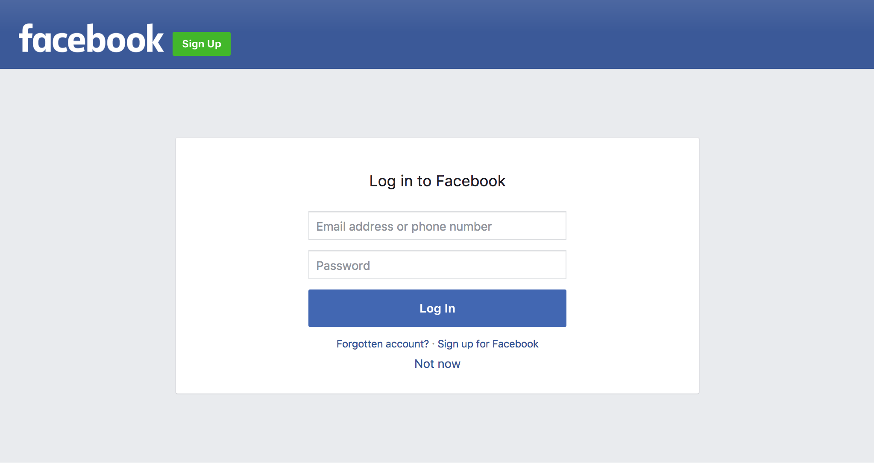
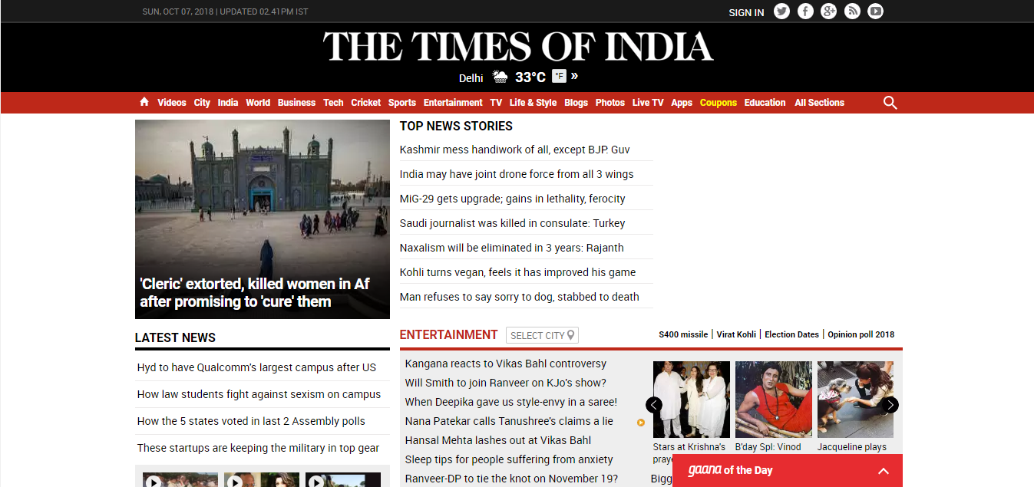
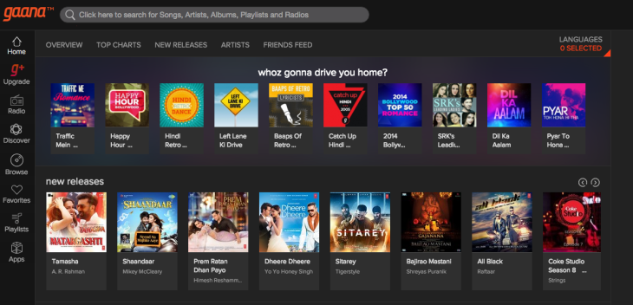
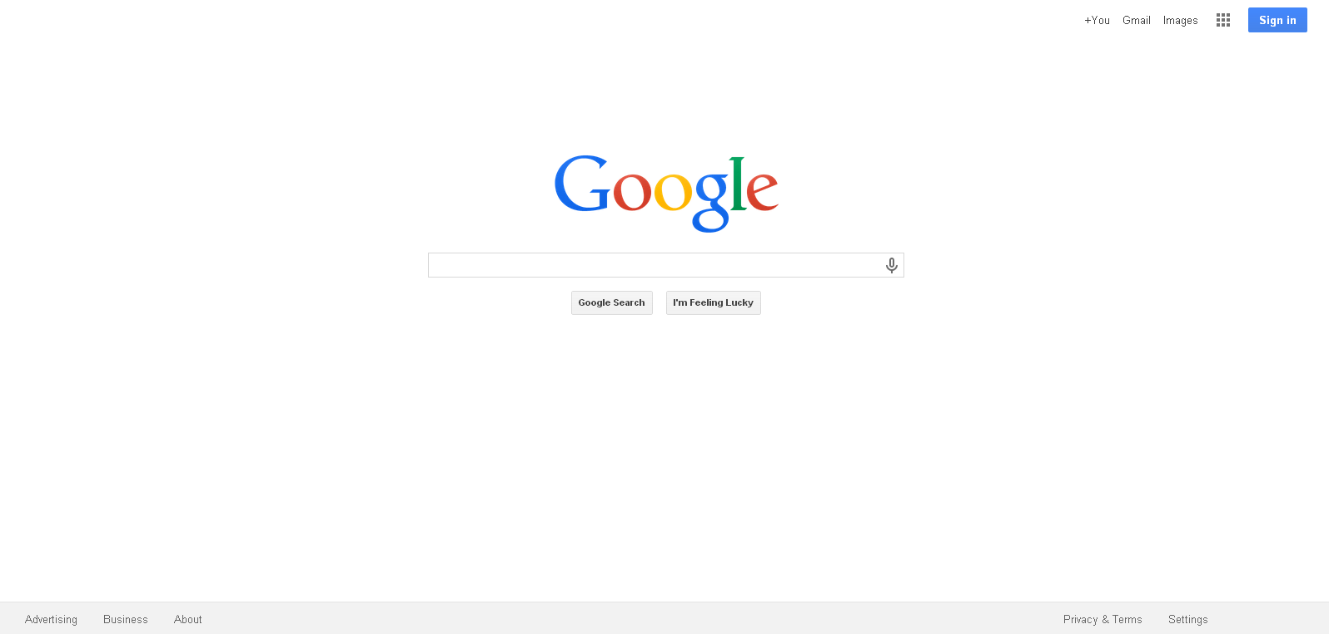

Slide 15
UI Development
Hypertext mark-up language
Notes:
HTML is Hypertext markup language or we can say *The Builder of web page*.

Slide 16
UI Development
Cascading style sheets
Notes:
CSS is Cascading style sheets, which I consider as *The Artist of web page*.

Slide 17
UI Development
JavaScript
Notes:
And JavaScript
They are all different languages, and work differently.

Slide 18
UI Development
Notes:
But HTML, CSS and JavaScript need one another to [change slide] make a beautiful and responsive website.

Slide 19

Notes:
- Imagine you want to code [change slide] this homepage using HTML, But just HTML.

Slide 20

Notes:
- But without CSS and JavaScript, an HMTL only website would look like this [change slide].
-

Slide 21
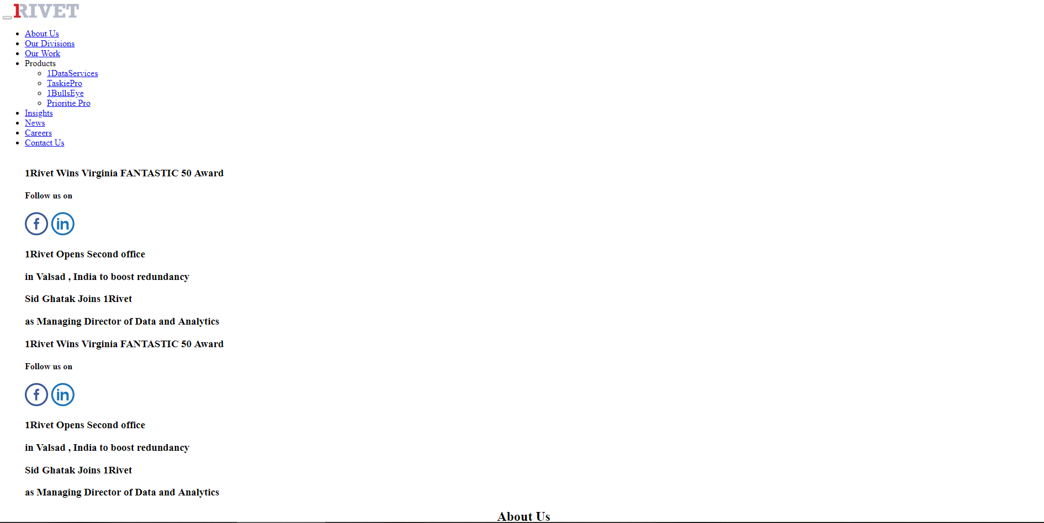

Slide 22
CSS – UI Development
Without Applying CSS & JavaScript To HTML
After Applying CSS & JavaScript To HTML
Notes:
CSS Adds the styling to a website.
CSS can’t live without HTML, or else there would be nothing to style.
So After applying the CSS and JavaScript, your website now look like this.

Slide 23
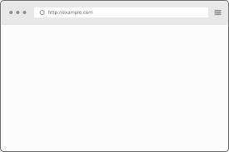
HTML – UI Development
Content & Text
Images
Links
<h1> Welcome To 1Rivet </h1>
<p> Top-ranked IT consulting firm </p>
<p> Good Morning! </p>
<img src=“1rivet-logo.png” alt=“1Rivet Logo” />
<a href=“www.1rivet.com/about”>About</a> <a href=“www.1rivet.com/news”>news</a>
<a href=“www.1rivet.com/career”>career</a>
Welcome To 1Rivet Top-ranked IT consulting firm Good morning!
About News Career
Notes:
HTML essentially would define all the content, the text, the images, the links, but simple HTML will not help you any more to lay your page out in better way.
So CSS come into the picture,

Slide 24
CSS – UI Development
Colors
Position
Fonts
h1 {
color: red;
}
p {
color: gray;
}
img {
width: 200px;
margin: 20px;
position: relative;
}
a {
font-size: 20px;
font-style: italic;
padding: 20px;
text-decoration: none;
}
Welcome To 1Rivet Top-ranked IT consulting firm Good Morning !
About News Career
Notes:
CSS is responsible for outlining the colors, the positioning of content, and the fonts.

Slide 25
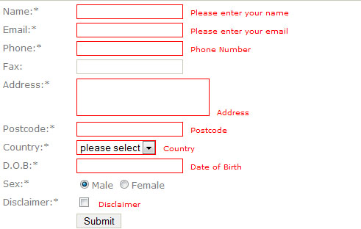
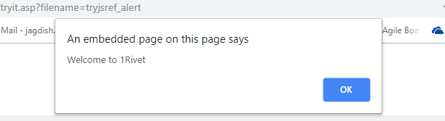
JavaScript – UI Development
Notes:
Now, Come to JavaScript
Very basic use of JavaScript, you may learn in your college, to show the alert box/popup box and may be for form validations.
But what I have understand is JavaScript is a HEART of any website, but HOW ?
Let’s have a look, Please disable the JavaScript from setting of your browser and now try to load google, YouTube, Gmail and so on.

Slide 26
JavaScript – UI Development
HTML
CSS
<h1> Welcome To 1Rivet </h1>
<p> Top-ranked IT consulting firm </p>
<p id="greeting"></p>
h1 {
color: red;
}
p {
color: gray;
}
Welcome To 1Rivet Top-ranked IT consulting firm Good Morning !
JavaScript
var thehours = new Date().getHours();
var themessage;
if (thehours >= 0 && thehours < 12) {
themessage = 'Good morning';
} else if (thehours >= 12 && thehours < 17) {
themessage = 'Good afternoon';
} else if (thehours >= 17 && thehours < 24) {
themessage = 'Good evening';
}
document.getElementById('greeting').innerHTML = themessage;
Notes:
Now Back to the same example, what we did using HTML and CSS,
Here, we have applied some JavaScript code to show the greeting dynamically.

Slide 27
UI Development
Notes:
Now that you understand importance of UI Technology and how they works together
here are 3 things to remember about HTML, CSS and JavaScript.

Slide 28

UI Development
3 THINGS TO REMEMBER
1
These Code languages =
UI/FRONT END DEVELOPMENT
2
These Code languages are
TRANSLATED BY BROWSERS
3
These Code languages
EVOLVE OVER TIME
Notes:
1. These Code languages = Front-End/UI Development
- UI Development is what you see when you land on a web page, but backend development is actually what makes an application on the web work.
2. These code languages are translated/rendered by the browsers only.
- Web browsers like Chrome, Edge, Mozila Firefox, opera, internet explorer translate these three languages into the visual web page.
- Without a browser these languages are just words on a page.
- Sometimes, website look slightly different on Chrome, Firefox and definitely on Internet Explorer. Because all the these browsers translate a little differently.
3. These Code Languages Evolve over Time
- HTML, CSS and JavaScript are constantly evolving.
- It’s just like other language, these coding languages have a history, They have been around for a few years now.
- On Oct 2004, HTML 5 was released as a W3C Recommendation.
- And on November 2016, HTML 5.1 was released as a W3C Recommendation.
There is a online community like w3c, manages the rules and best practices of these coding languages.
-

Slide 29
UI Development
Notes:
So the bottom line of this session is :
whatever you see on the world wide web, you have to thanks these 3 HEROS: HTML CSS and JavaScript.

Slide 30

THANK YOU
“Design is not just what it looks like and feels like. Design is how it works” -Steve Jobs

